Slide 1
Performance Comparison of Two Statistical Learning Algorithms
GROUP - E

Slide 2
Introduction
Background:
In today's competitive restaurant industry, accurately predicting revenue is essential for driving growth and profitability. Understanding the factors influencing restaurant revenue can provide valuable insights into consumer behaviour, market trends, and operational efficiency.
Machine Learning (ML) can predict by revenue analyzing properties, providing an objective assessment
Objective:
This Study focuses on predicting restaurant revenue using machine learning, comparing Linear Regression and Regression Decision Tree.
Aim :
This report aims to evaluate these two models across various performance metrics, exploring their strengths, weaknesses, and suitability for different data structures and prediction scenarios.

Slide 3
Problem Statement & Methodology
Problem Statement:
Evaluate Linear Regression and Regression Decision Tree models across various performance metrics, exploring their strengths, weaknesses, and suitability for different data structures and prediction scenarios
Dataset Summary :
Source: Restaurant Revenue dataset with 1000 samples .
Features: 8 features including both numerical and categorical data.
Target: Monthly Revenue.
Null values: There are no null values present in the dataset
Duplicates: There are no duplicates in dataset
Data Preprocessing :
Drop column: We removed the "cuisine_type" and "promotions" columns from the dataset.
Outliers: Box plots were utilized to identify outliers in the dataset.

Slide 4
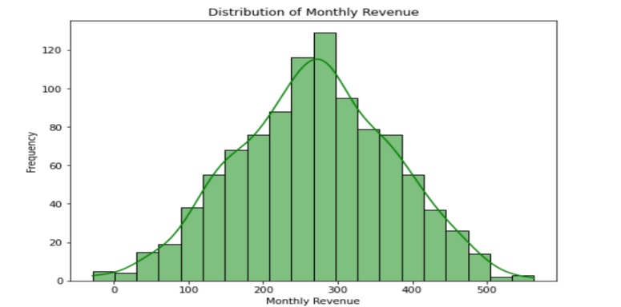
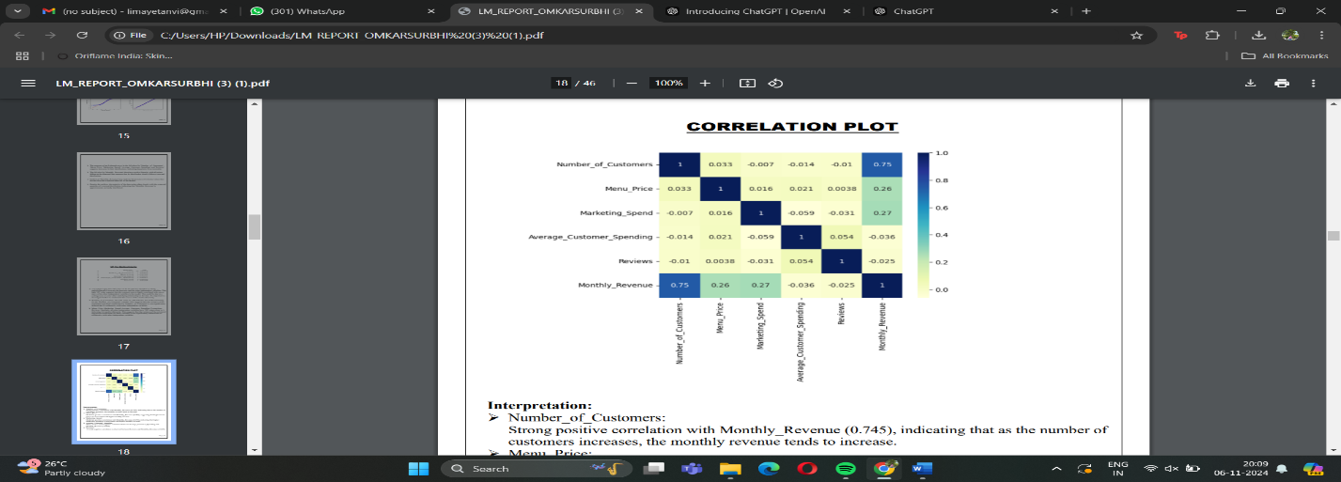
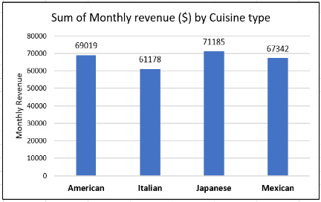
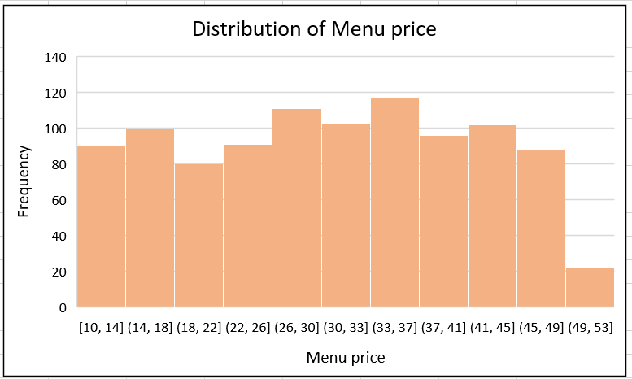
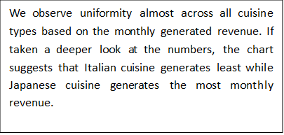
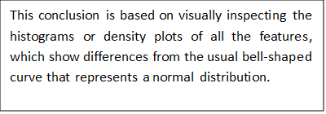
Exploratory Data Analysis (EDA):
Histograms for Normality Check: Histograms were plotted for each remaining feature, to assess whether they approximate a normal distribution.
Correlation Plot: To analyse relationship between dependent and independent variables.
0
Our target variable,'Monthly_Revenue', demonstrates a relatively normal distribution cantered around mean equal to 270.
The number of customers shows a strong positive correlation with monthly revenue (0.745), while menu price (0.260) and marketing spend (0.270) have moderate positive correlations. Average customer spending (-0.036) and reviews (-0.025) show weak negative correlations with monthly revenue.

Slide 5
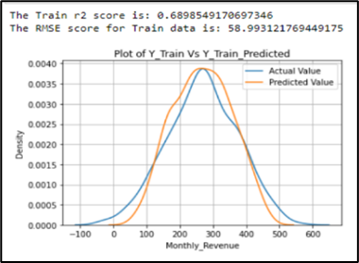
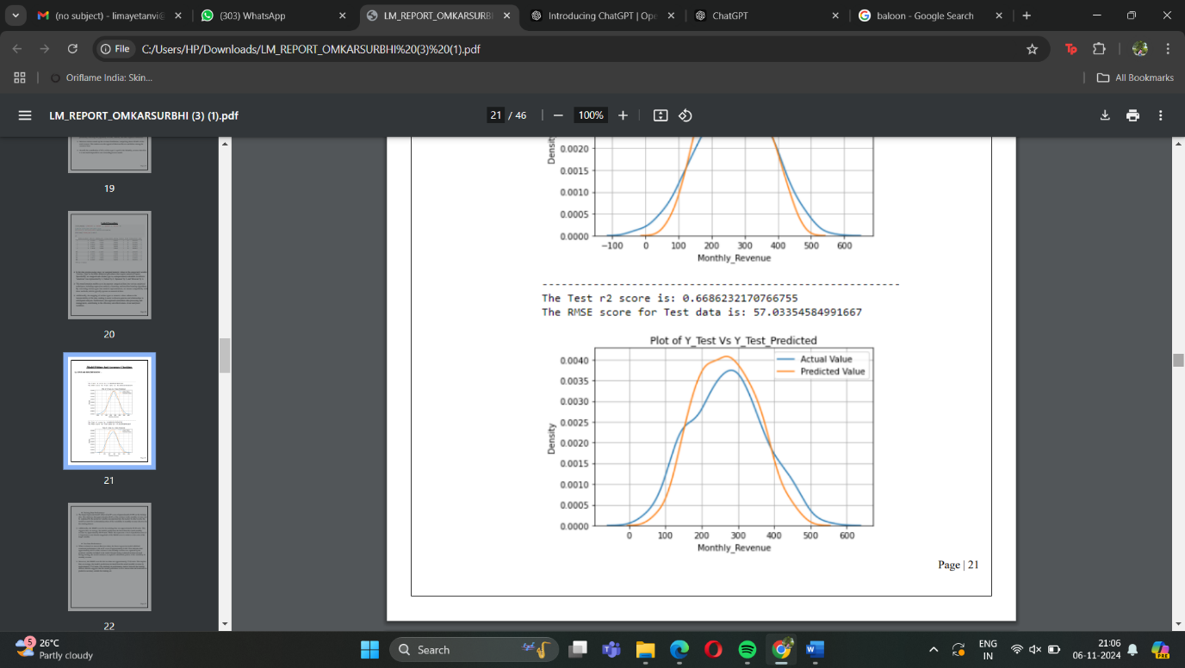
MULTIPLE LINEAR REGRESSION
Model Selection: Multiple Linear Regression (MLR) chosen for its ability to predict monthly revenue based on multiple independent variables.
Training Performance:
R²: 0.690 (69.0% of revenue variance explained)
RMSE: 58.99 units (average deviation from actual revenue)
Test Performance:
R²: 0.669 (66.9% of revenue variance explained)
RMSE: 57.03 units
Advantages: MLR captures the effect of multiple predictors on the dependent variable. Disadvantages: Sensitive to outliers, assumes linearity, prone to multicollinearity.

Slide 6
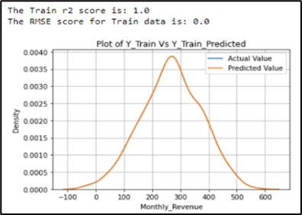
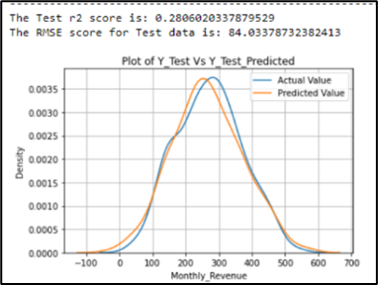
Regression Decision Tree
Model Selection: Regression Decision Tree chosen for its flexibility in handling both categorical and numerical data.
Training Performance:
R²: 1.0 (perfectly fits the training data, indicating potential overfitting)
RMSE: 0.0 (predictions align exactly with actual values)
Test Performance:
R²: 0.281 (explains 28.1% of variance in test data)
RMSE: 84.03 (average prediction error in test data)
Advantages: No feature scaling required, handles both categorical and numerical data. Disadvantages: Prone to overfitting with deep trees, sensitive to small changes in data.

Slide 7
Results
Model comparison
1. Linear Regression:
Training Set R²: 0.6899
Test Set R²: 0.6686
Interpretation: Linear Regression shows a moderate R² score on both the training and test sets, indicating a decent fit of the linear regression model to the data.
2. Regression Decision Tree:
Training Set R²: 1.0000
Test Set R²: 0.2283
Interpretation: Regression Decision Tree achieves a perfect R² score of 1.0000 on the training set, suggesting overfitting as it perfectly fits the training data. However, its performance drops significantly on the test set (R² = 0.2283), indicating poor generalization to unseen Data.
Conclusion
•Linear Regression provides a moderate R² score on both the training set (0.6899) and test set (0.6686). This suggests that the model fits the data well, generalizing reasonably well to unseen data. The consistent performance across both datasets indicates that the model is not overfitting and is able to capture the underlying trend in the data without being overly sensitive to noise.
•Regression Decision Tree, on the other hand, shows a perfect R² of 1.0000 on the training set, indicating overfitting. The model has perfectly learned the patterns in the training data, but its performance drastically drops on the test set (R² = 0.2283), indicating poor generalization. This sharp decline in performance demonstrates that the Regression Decision Tree is too specific to the training data and does not adapt well to new, unseen data.
The most important advantages of Linear Regression over Regression Decision Tree are:
1.Better Generalization: Linear Regression performs consistently on both training and test sets, ensuring the model generalizes well to unseen data, while Regression Decision Trees are prone to overfitting and have poor performance on new data.
2.Less Overfitting: Linear Regression is less complex and less likely to overfit the training data, unlike Regression Decision Trees, which can become overly specific to the training set, leading to poor generalization.
Thus, while Regression Decision Trees may excel in capturing complex relationships, their susceptibility to overfitting and instability makes Multiple Linear Regression a more reliable choice when generalization to unseen data is crucial.

